Slide 1











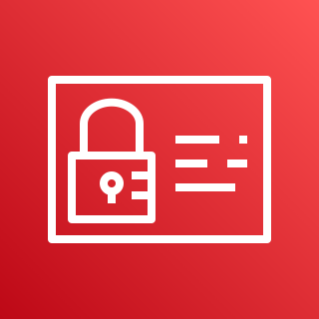

AWS Cloud
VPC
Production Cluster
Users
Availability Zone: us-east-1a
Availability Zone: us-east-1b
Amazon Route 53
Public subnet
Public subnet
SSL
Application Load Balancer
SSL Redirect
game.solankiempire.site
Ums- Application Load Balancer Service (Ingress)
NAT gateway
/*
NAT gateway
HTTPS URLS
https://game.solankiempire.site/usermgmt/users
/game/*
Private subnet
Private subnet
EC2 Worker Node-1
2048- NodePort SVC
User Management – Node Port Service
AWS Certificate Manager
Deployment: 2048
N
U
EKS Private NodeGroup
Pod
Pod
ReplicaSet
ReplicaSet
Deployment: UMS
AWS Identity and Access Management (IAM)
MySQL – External Name Service
Amazon RDS DB(worker)
Amazon RDS DB (master)

